Slide 1

“We don’t merely book your travel; we can help you realize your travel dreams if you give us an idea of what kind of experience you seek.”
35 Alexandra kazbegi avenue,
Tbilisi georgia
+995592135597
+995555560853
Whatsapp:
+918129362672
+918547510259
kabeerkabri@gmail.com
ranees010lw@gmail.com

Slide 2
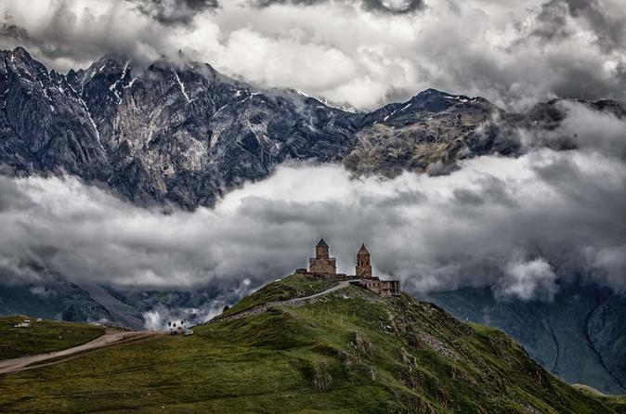
Kazbegi
ყაზბეგი
According to tradition, stepantsminda, literally “Saint Stephan”, was named so after a Georgian Orthodox momk Stephan, who constructed a hermitage at this location on what later became the Georgian Military Highway. It came under the control of a local feudal magnate. The chopikashvili clan. Who were in charge of collecting tolls on travelers in the are in the late 18th century.
Stepantsiminda is known for its scenic location in the Greater Caucasus mountains, and is a center for trekkers and mountain climbing, Local attractions include the Kazbegi Museum and Ethnographic Museum in town, and the Great Trinity Church outside of town, as well as Mount Kazbegi itself and the alpine meadows and forests of the surrounding Kazbegi Nature Reserve

Slide 3
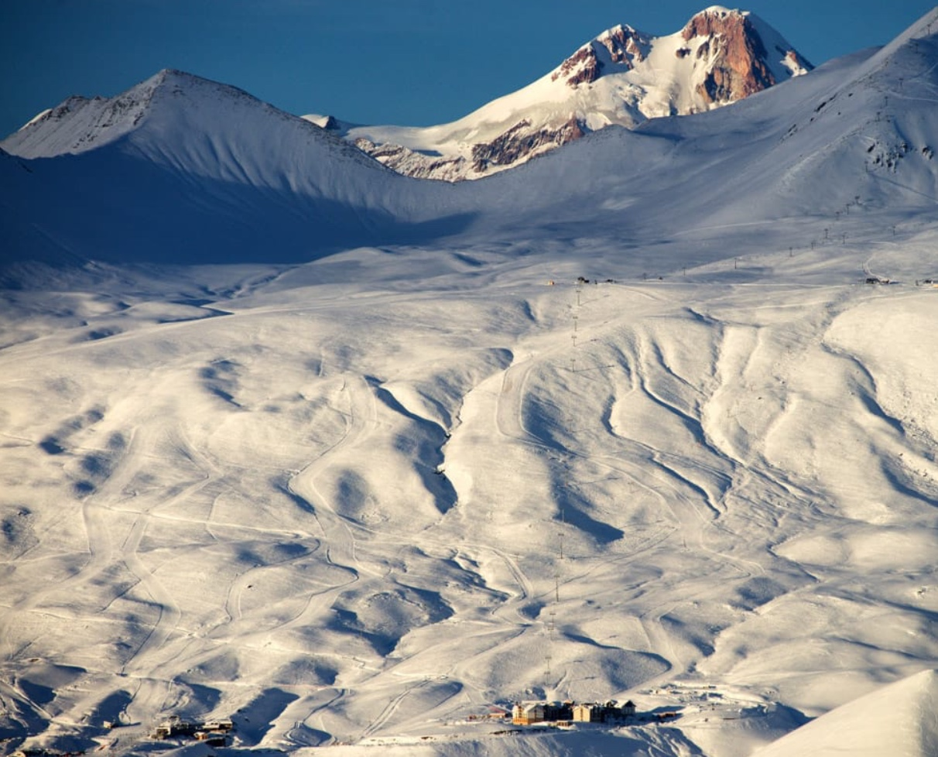
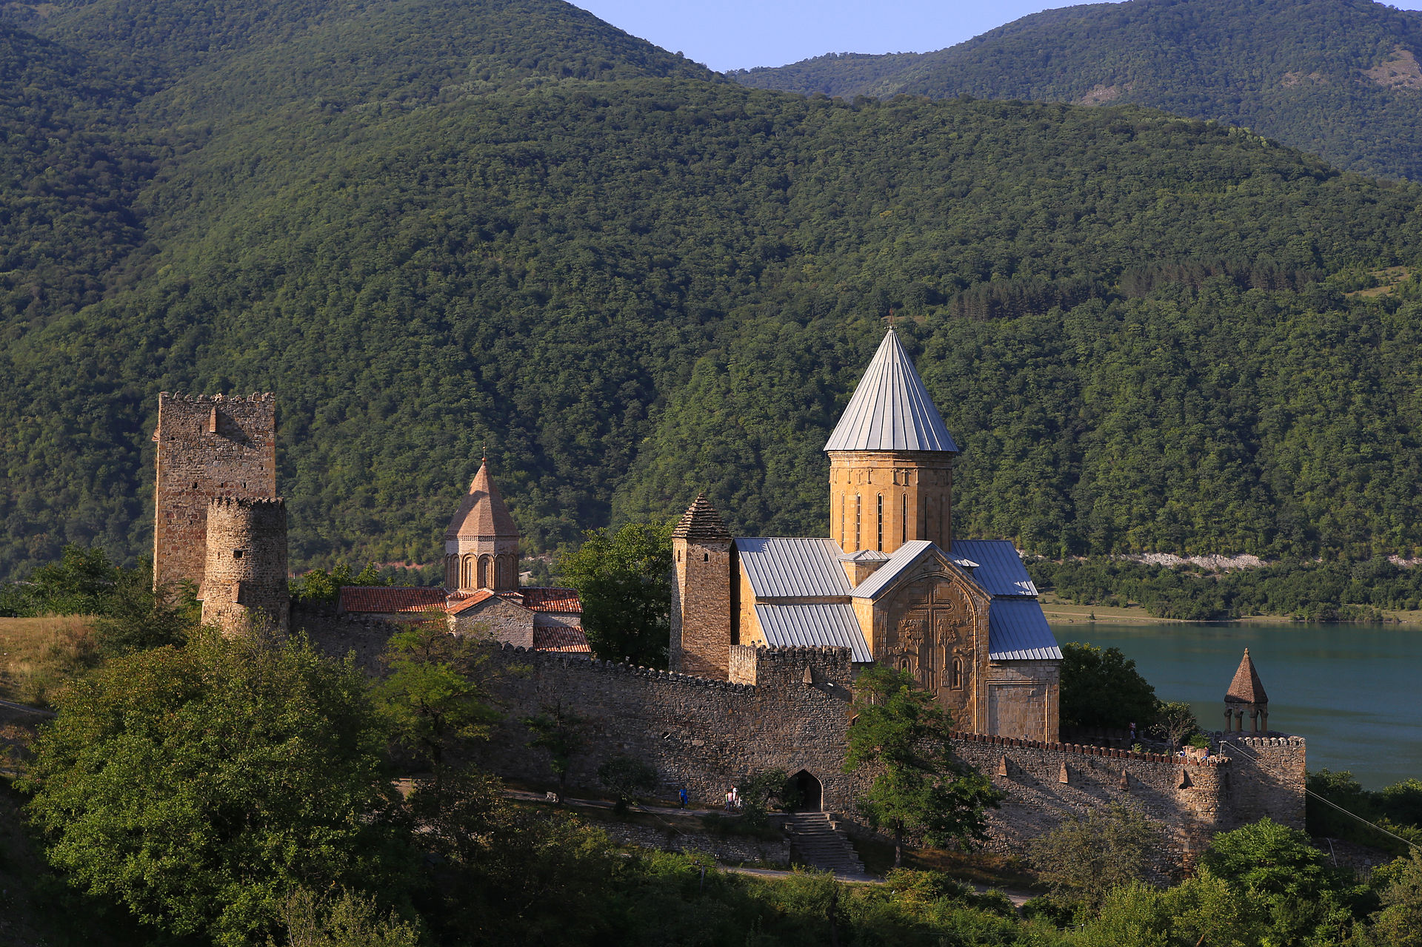
Kazbegi
ყაზბეგი
Gudauri
Ananuri

Slide 4
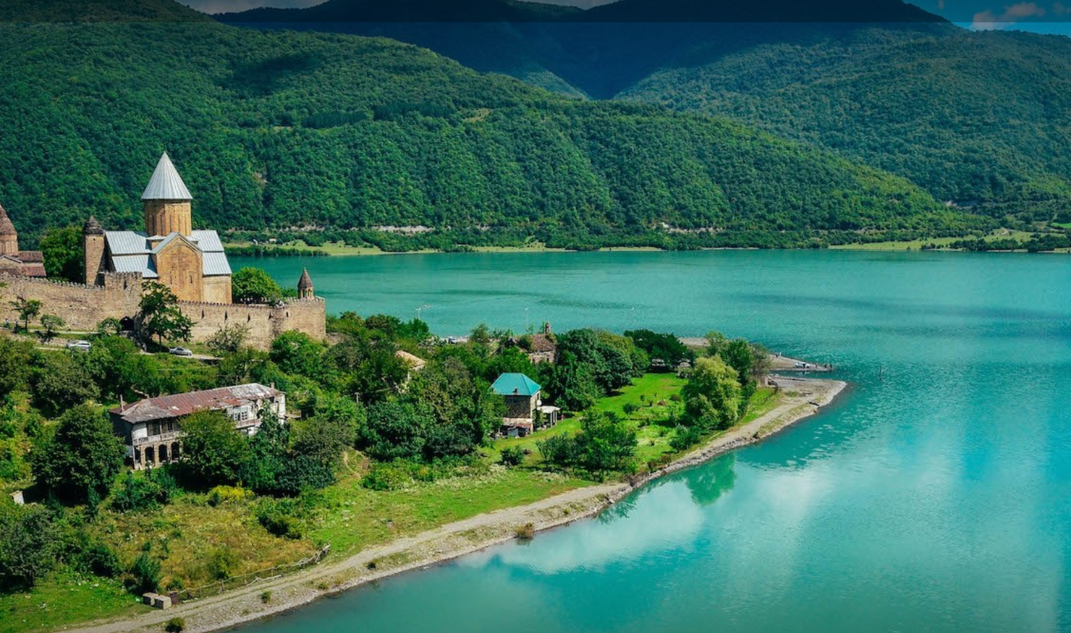
Ananuri
ანანური
Ananuri is a castle complex on the Aragvi River in Georgia, about 45 miles (72 kilometres) from tbilisi
Ananuri was a castle and seat of the eristavis (Dukes) of Aragvi, a feudal dynasty which ruled the are from the 13th century, the castle was the scene of numerous battles.

Slide 5
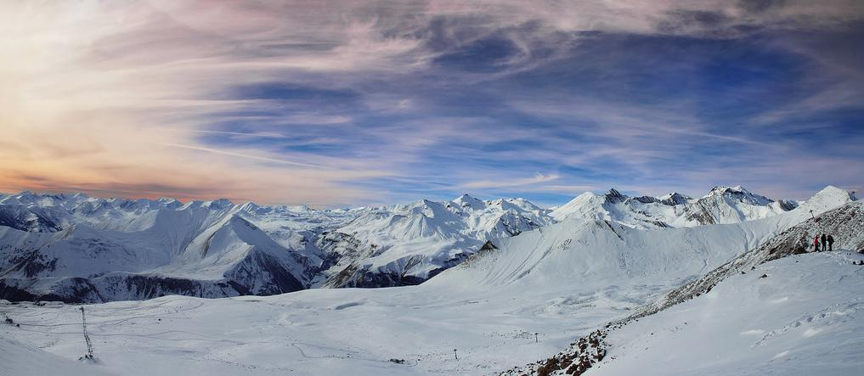
Gudauri
გუდაური
Heliski
provides skiers with access to some of the finest powder-snow in the Caucasus. With helicopters granted almost unrestricted access to local mountains, skiers can experience some of the most sublime runs in Europe - at altitudes between 1,500 and 4,200 meters above sea level. The helicopters drop clients off on mountain tops, glaciers, fabulous ridges, and in the hands of highly experienced guides.
Speed riding and paragliding
Gudauri is Georgia's most renowned site for speedriding and paragliding. Experienced instructors are employed to accompany customers in the said activities.

Slide 6
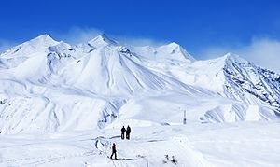
Gadauri
Ski touring
The Gadauri ski resort area and Kazbek massif are excellent for ski touring - is a great way to access nature as it was intended to be seen. The lifts provide easy access to the mountain wilderness that make this region special. With the necessary equipment and a bit of hard work, riders will be able to escape the crowds on the slopes and find some great skiing.

Slide 7
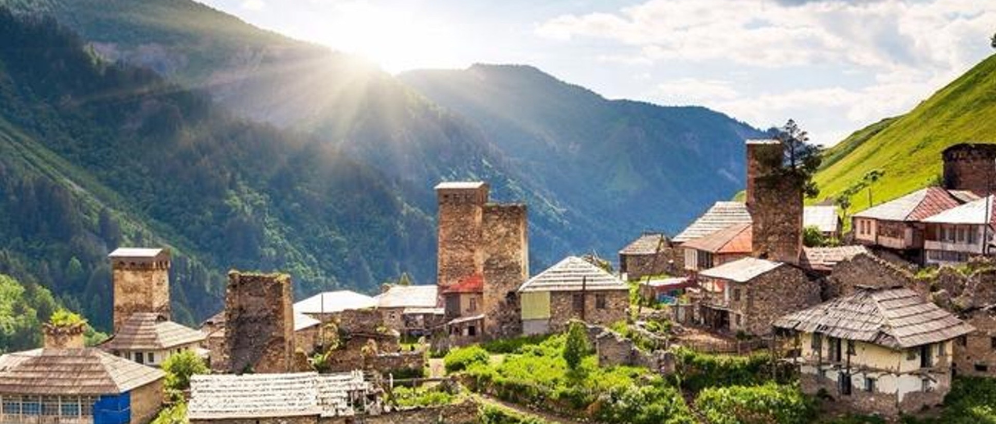
Kutaisi
ქუთაისი
Kutaisi is a city in west Georgia. It's home to the centuries-old Bagrati Cathedral. On the city's outskirts, the Gelati Monastery is a medieval cathedral with elaborate frescoes. The nearby hillside Motsameta Monastery has martyrs' remains. Historical Georgian manuscripts, ceramics and textiles are on display at the Kutaisi State Historical Museum. To the northwest, Prometheus Cave features petrified waterfalls.

Slide 8
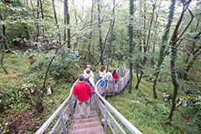
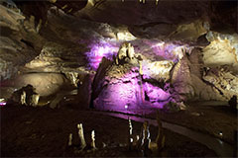
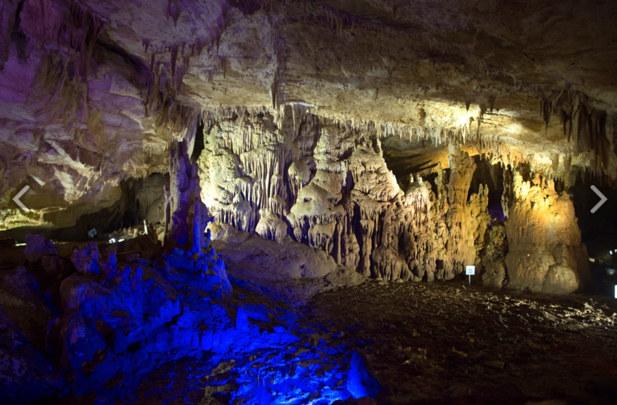
Kutaisi
Kumistavi (Prometheus) CaveKumistavi cave, also known as the cave of Prometheus, is located near the Georgian town of Tskhaltubo, 20 km away from Kutaisi in Imereti region in the West of the country. The cave was discovered in 1984 and was almost immediately developed as a show cave. Kumistavi is the biggest cave in Georgia. Although only one tenth is open for tourists, it takes about an hour to explore it. Inside there are underground lakes and rivers; rather high humidity and a lot of bats, which, however, do not bother tourists, as they fly very high.

Slide 9
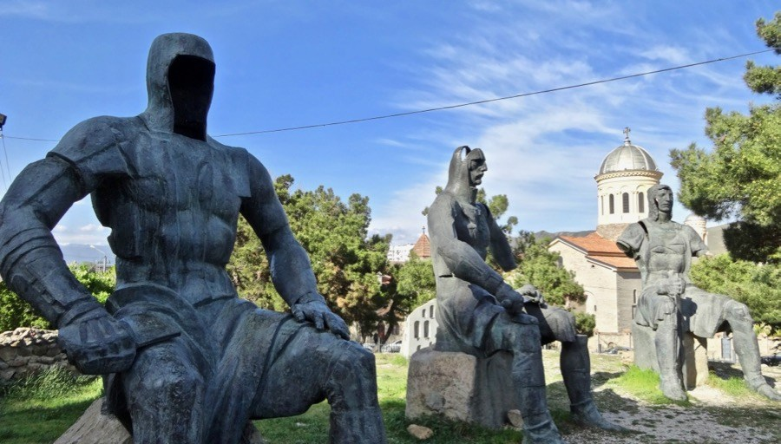
Gori
გორი
Joseph Stalin Museum – The main corpus of the complex is a large palazzo in Stalinist Gothic style, built in 1951 ostensibly as a local history museum, but clearly intended to become a memorial to Stalin, who died in 1953. The exhibition is chronologically divided into several rooms, which keeps a lot of exhibits that are actually or allegedly owned by Stalin, including furniture, personal items and gifts. There are also exhibits on display in the form of documents, photographs, drawings and newspaper articles.

Slide 10
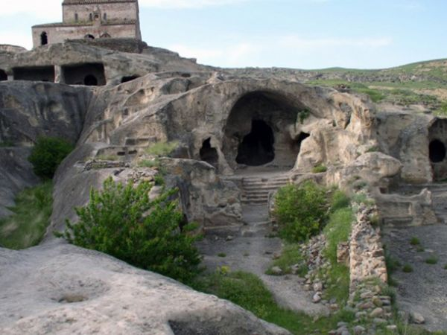
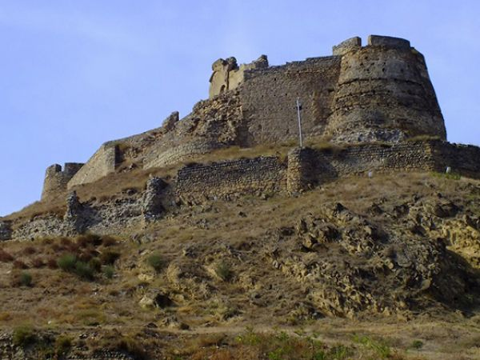
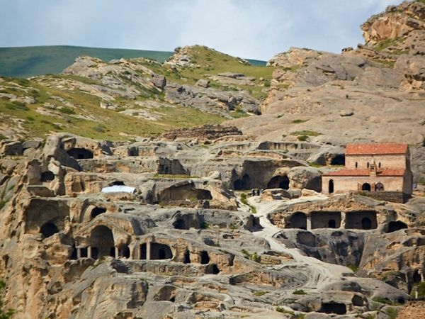
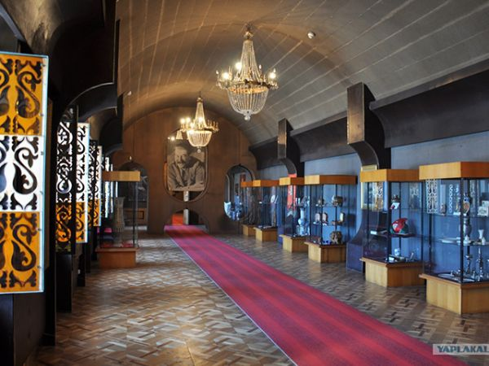
Gori
Uplistsikhe - "King of the castles" – is an ancient rock-hewn town in eastern Georgia, some 10 kilometers east of the town of Gori, Shida Kartli. Built on a high rocky left bank of the Mtkvari River, it contains various structures dating from the Early Iron Age to the Late Middle Ages, and is notable for the unique combination of various styles of rock-cut cultures from Anatolia and Iran, as well as the co-existence of pagan and Christian architectureUplistsikhe is identified by archaeologists as one of the oldest urban settlements in Georgia. Strategically located in the heartland of ancient kingdom of Kartli (or Iberia as it was known to the Classical authors), it emerged as a major political and religious center of the country.

Slide 11
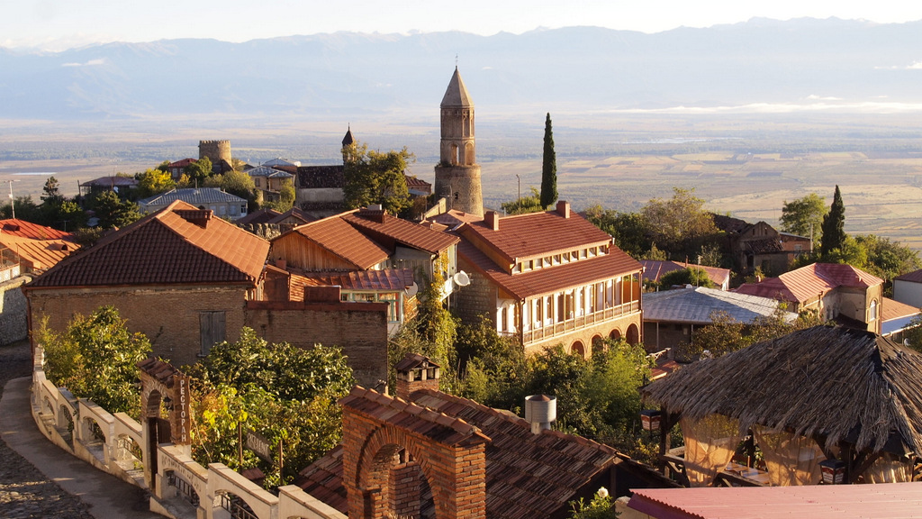
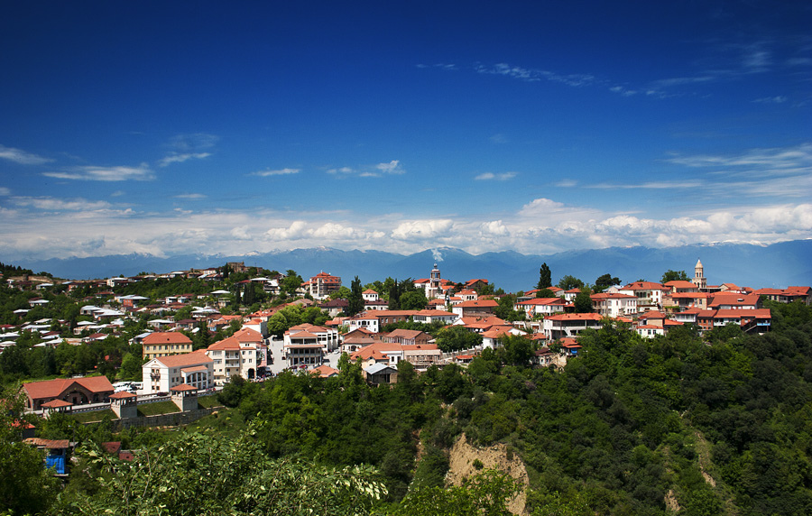
SignAgi
სიღნაღი
Is a town in georgia’s easternmost region of kakheti and the administrative center of the signagi municipality. Although it is one of Georgia’s smallest towns. Signagi serves as a popular tourist destination due to its location at the heart of georgia’s wine- growing regions, as well as its picturesque landscapes, pastel houses and narrow, cobblestone streets. Located on a steep hill. Signagi overlooks the vast Alazani valley, with the Caucasus mountains visible at a distance.

Slide 12
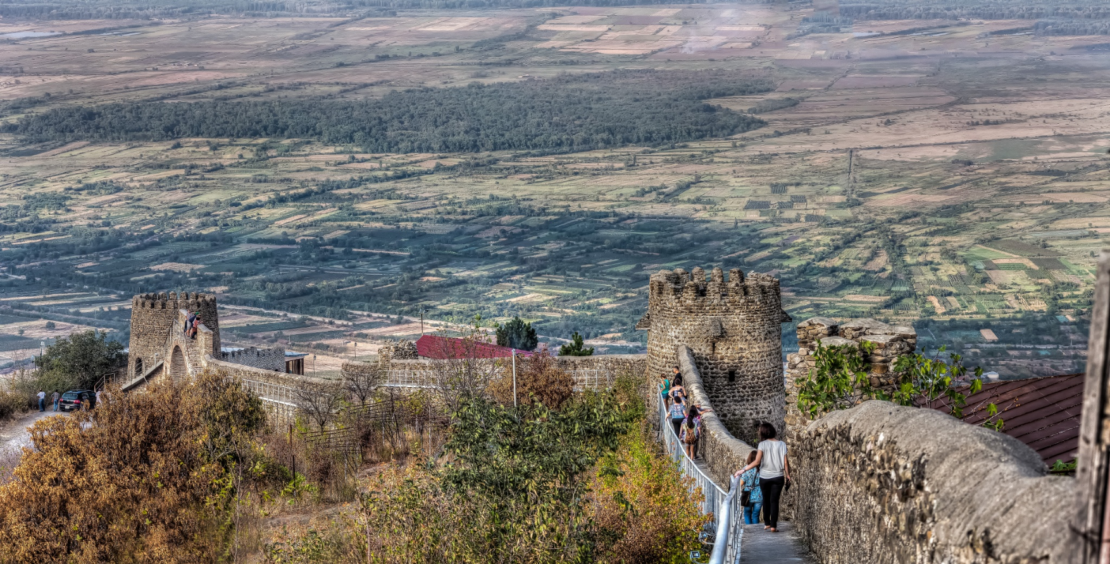
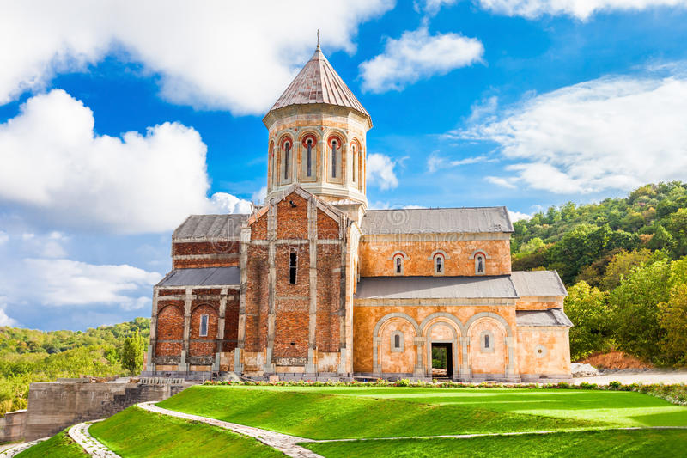
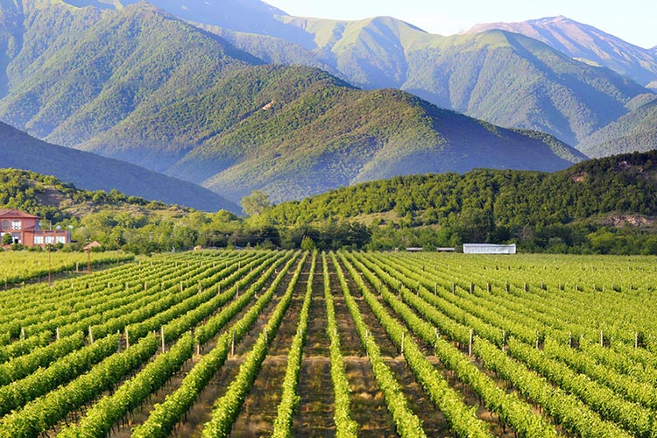
Signagi
Signagi wall
Bodbay monastery
Kakheti winery

Slide 13
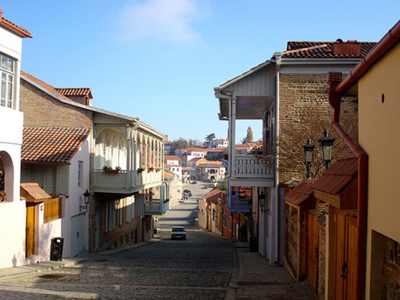
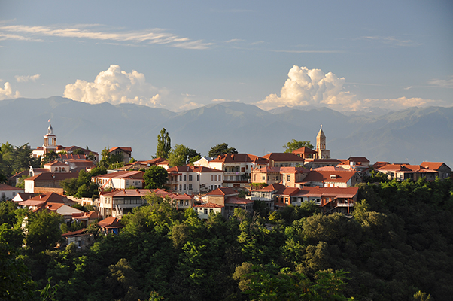
Kakheti
კახეთი
Kakheti, Georgia’s famous wine district lies due east from Tbilisi in a land dotted with fine old churches and vineyard after vineyard. Stop at any home and be offered delicious homemade wine.

Slide 14
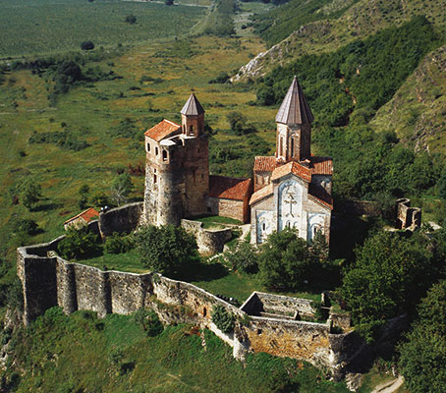
Kakheti
Historically Kakheti was often the centre of political turmoil however some of the most beautiful and important buildings were erected here and the church architecture is as diverse as wines in the region. Sighnaghi is a beautiful hill-town surrounded by medieval wall and providing panoramic views of the Alazani valley and Caucasus Mountains. Kakheti is the major producer of Georgian wines.

Slide 15
Packages..
City tour, kazbegi
City tour, kazbegi, signagi kakheti
City tour, kazbegi, signagi kakheti, kutaisi
City tour, kazbegi, signagi kakheti, kutaisi & gori
2 day package
3 day package
4 day tour package
5 day tour package
“We recommend sky high Travel to anyone who will listen to us. They anticipated every need and solved every potential stressor.”
~ Mr. RAHEEM

